Slide 1
Developing a Text Classification Model for Identifying Suicidal Ideation using Natural Language Processing Techniques
By
Arya Manikya Sinha (Roll no.-20191040, Regn. No.- A7560 of 2019-20)
Debjyoti Prodhan (Roll no.-20191059, Regn. No.- A7553 of 2019-20)
Souvik Modak (Roll no.-20191057, Regn. No.- A7552 of 2019-20)
Nirnay Ghosh (Roll no.-20191061, Regn. No.- A7554 of 2019-20)
Under the Supervision of
Mr. Sumit Gupta
Assistant Professor, CSE Department
University Institute of Technology, The University of Burdwan

Slide 2
Contents
Objective
Introduction
Related Works
Proposed Methodology
Proposed System 1
Proposed System 2
Implementation
Result
Conclusion
Future Work

Slide 3
Objective
“To identify signs of depression and predict the presence of suicidal tendencies in texts using Natural Language Processing techniques.”

Slide 4
Introduction
As per the World Health Organization (WHO), suicide is a primary cause of death among individuals between 15-29 years old worldwide [1].
Depression and suicide are two of the most critical mental health problems prevalent in the current era. It is estimated that depression affects over 264 million people globally, while suicide is responsible for over 800,000 deaths annually, leading to increased suicidal ideation [2, 3].
Suicidal ideation is one of the most critical symptoms of depression and is often difficult to detect [4].

Slide 5
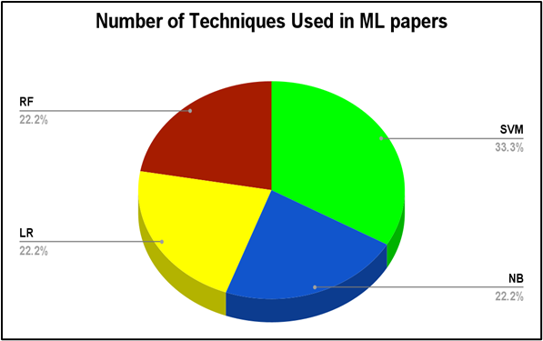
Related Works
Four commonly used ML classifiers are SVM, NB, RF, and LR.
Rabani et al. [5] suggest that the performance of RF is best with an accuracy of 98.5%, while NB has the lowest accuracy at 81.7%.
In paper [6], the authors have implemented SVM and Bag of Words (BoW) for binary classification, achieving a macro F1 score of 0.78-0.81.
Figure 1. Pie chart depicting the commonly used ML techniques as per ML-based existing works on Suicidal Ideation.

Slide 6
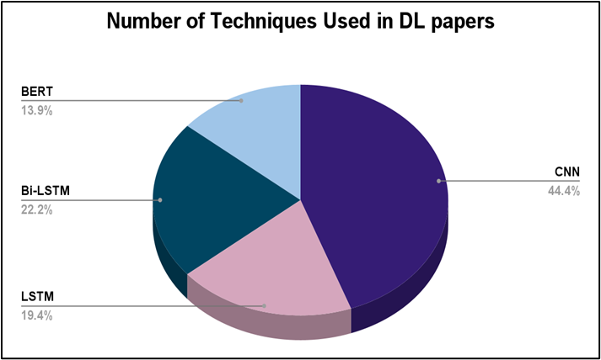
Related Works (contd.)
Four commonly used DL classifiers identified are CNN, Bi-LSTM, LSTM and BERT.
Kim et al. [7] demonstrate CNN's strong performance by achieving an accuracy range of 75.13% to 96.96%.
In [8], Bi-LSTM and BERT outperform CNN on a large dataset with well-selected embedding.
Figure 2. Pie chart depicting the commonly used DL techniques as per DL-based existing works on Suicidal Ideation.

Slide 7
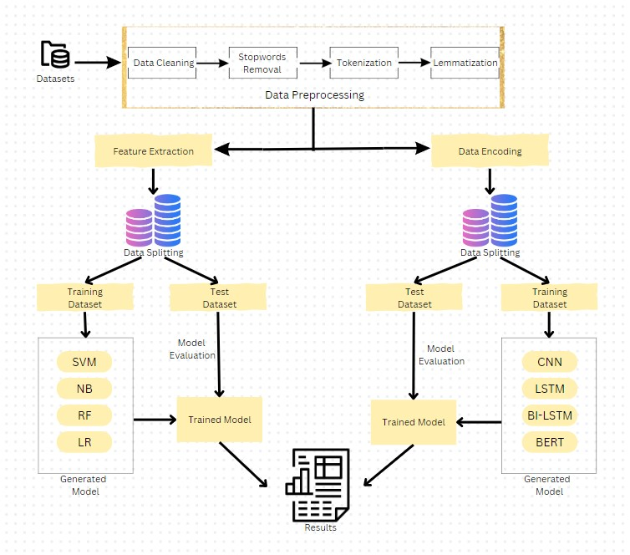
Proposed System 1
Figure 3: Architectural Framework of Proposed System 1

Slide 8
Proposed System 1(contd.)
Step 1. Data Preprocessing
Data Cleaning
Stopword Removal
Tokenaization
Lematization
Step 2. Feature Extraction
TF-IDF (unigram and bigram)
Bag-of-Word (unigram and bigram)
Step 3. Encoding
One-hot encoding
Step 4. Data Splitting
80:20 split
5-fold
10-fold
Step 5. Model Selection and Training
Step 6. Evaluation
Step 7. Testing and Deployment

Slide 9
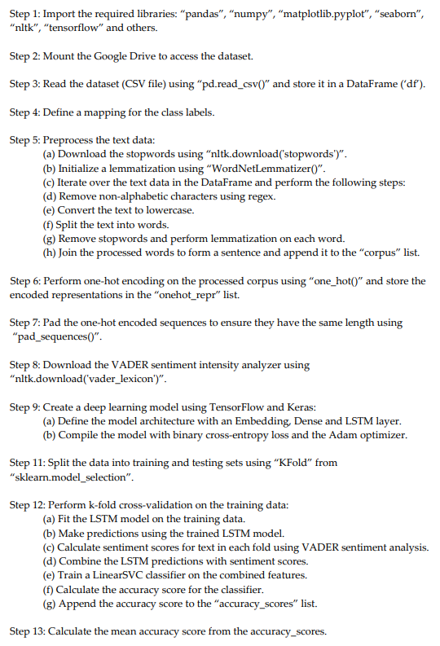
Proposed System 2
Figure 4. Algorithm of Proposed System 2

Slide 10
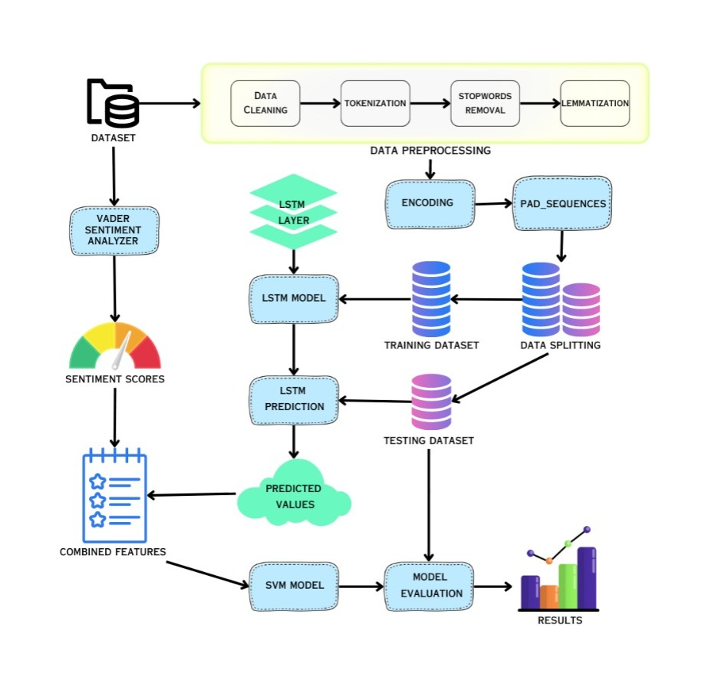
Proposed System 2(contd.)
Figure 5: Architectural Framework of Proposed System 1

Slide 11
Implementation
Coding Environment:
Python and its associated libraries such as scikit-learn, Keras, and TensorFlow
“Google colab” Platform
Datasets:
The Reddit C-SSRS Suicide Dataset (Reddit Dataset)[9]
The SDCNL Dataset [10]
The Life_Corpus Dataset [11]
The CEASE Dataset [12]
The SWMH Dataset [13]
The Suicide and Depression Detection (SDD) Dataset[14]
Train-test split ratio:
80:20 split
5-fold
10-fold

Slide 12
Results
Table 1. Accuracy Scores Obtained for Different Datasets Using Machine Learning Approach
Datasets | Machine Learning
 | SVM |  |  | NB |  |  | RF |  |  | LR
 | 80:20 | 5-fold | 10-fold | 80:20 | 5-fold | 10-fold | 80:20 | 5-fold | 10-fold | 80:20 | 5-fold | 10-fold
Reddit Dataset | 75 | 80 | 81 | 77 | 82 | 82 | 77 | 78 | 78 | 77 | 81 | 80
SDCNL | 70 | 70 | 68 | 69 | 68 | 67 | 68 | 66 | 65 | 71 | 71 | 69
SDD Dataset | 94 | 93 | 93 | 92 | 92 | 92 | 83 | 83 | 83 | 93 | 93 | 93
Life_Corpus | 80 | 80 | 82 | 75 | 77 | 80 | 80 | 80 | 81 | 80 | 81 | 82
CEASE | 78 | 78 | 79 | 75 | 72 | 72 | 67 | 66 | 66 | 78 | 77 | 78
SWMH | 54 | 80 | 80 | 52 | 79 | 79 | 53 | 75 | 74 | 54 | 81 | 82

Slide 13
Results(contd.)
Table 2. Accuracy Scores Obtained for Different Datasets Using Deep Learning Approach
Dataset | Deep Learning
 | LSTM |  |  | Bi-LSTM |  |  | CNN |  |  | BERT
 | 80:20 | 5-Fold | 10-Fold | 80:20 | 5-Fold | 10-Fold | 80:20 | 5-Fold | 10-Fold | 80:20
Reddit Dataset | 82 | 91.2 | 93 | 82 | 78.4 | 78.4 | 81 | 78.4 | 78.4 | 78
SDCNL | 67 | 93.5 | 95 | 62 | 63.2 | 61.1 | 66 | 59.4 | 60.7 | 55
SDD Dataset | 88 | 92.5 | 92 | 87 | 85 | 86 | 86 | 86 | 88 | 80
Life_Corpus | 85 | 90 | 92.8 | 85 | 68.2 | 70 | 87 | 67 | 57.4 | 85
CEASE | 76 | 92.8 | 93.2 | 77 | 67.2 | 68 | 77 | 64.4 | 65 | 68
SWMH | 71 | 87 | 91 | 73 | 73 | 74 | 68 | 70 | 71 | 60
Table 3. Accuracy of selected datasets using Proposed System 2
Model | Datasets
 | Reddit Dataset | SDCNL | SDD Dataset | Life_Corpus | CEASE | SWMH
Proposed System 2 | 97.4 | 94.4 | 93.7 | 97.14 | 99.2 | 91.5

Slide 14
Results(contd.)
Table 4. Performance Comparison of Proposed Work with other existing Suicidal Ideation systems
Datasets | Authors | Technique / Features | Reported Result
Reddit Dataset | Gupta et al. [11] | NB, Semantic Features | 71
 | Proposed System 1 | LSTM | 82
 | Proposed System 2 | Hybrid model | 97.4
SDCNL | Proposed System 1 | LR, TF-IDF(1), TF-IDF(2) | 71
 | Proposed System 2 | Hybrid model | 94.4
 | Haque et al [36] | guse-dense with UMAP-KMeans | 98.18
SDD Dataset | Proposed System 2 | Hybrid model | 93.7
 | Proposed System 1 | SVM, TF-IDF(1), TF-IDF(2) | 94
 | Yi et al [47] | Electra | 97
Life_Corpus | Caicedo et al [8] | Rasa | 0.49 ± 0.02 (Macro f1)
 | Parraga-Alava et al [20] | Hierarchical clustering. average | 0.79 (F1)
 | Proposed System 1 | CNN | 87
 | Caicedo et al [16] | POS, SYNSETS, lemma, word RandomCommitte | 0.958 (F1)
 | Proposed System 2 | Hybrid model | 97.14
CEASE | Ghosh et al [32] | CNN | 59.54
 | Proposed System 1 | CNN | 77
 | Proposed System 2 | Hybrid model | 99.2
SWMH | Ji et al [46] | RN | 64
 | Proposed System 1 | Bi-LSTM | 73
 | Proposed System 2 | Hybrid model | 91.5
The Proposed System 2 manages to perform better when compared to other existing works for four datasets viz. Reddit, Life_Corpus, CEASE, and SWMH with an accuracy score of 97.4%, 97.14%, 99.2%, and 91.5% respectively.
But for SDCNL & SDD Dataset the Proposed System 2 is unable to beat the result of existing works

Slide 15
Conclusion
Project focus: Identifying suicidal intent through depression detection from texts using ML and DL techniques.
Research analysis: Multiple research works were analyzed to identify suitable features, ML, and DL techniques.
Dataset collection: Six different datasets were collected from previous research papers.
Proposed System 1: Workflow proposed with system architecture and flowchart. Features extracted: BoW (unigram), TF-IDF (unigram), BoW (bigram), TF-IDF (bigram). ML classifiers: SVM, NB, LR, RF. DL classifiers: LSTM, Bi-LSTM, CNN, BERT. Accuracy results for different datasets.
Proposed System 2: Workflow proposed with system architecture and flowchart. A hybrid approach using LSTM, SVM, and VADER Lexicon. Accuracy results for different datasets.
Comparison: Proposed systems outperform existing works for Reddit, Life_Corpus, CEASE, and SWMH datasets. Promising results for SDCNL and SDD datasets, but further research is needed.
Overall, the proposed models show better performance and accuracy compared to existing works in several datasets. However, there is room for improvement and further research on specific datasets.

Slide 16
Future Work
Word embedding techniques such as “Word2vec”, “GloVe”, “FastText” & “ELMo embedding” can be utilized.
Proposed model can be trained with other datasets such as CEASE v2.0 etc.
A GUI-based application for common user can be developed.
Detection suicidal tendencies from handwritten notes can be a potential domain for further research.

Slide 17
References
[1].World Health Organization, “Depression and Other Common Mental Disorders: Global Health Estimates,” Retrieved from https://www.who.int/publications/i/item/depression-global-health-estimates, 2017.
[2].World Health Organization, “Preventing suicide: A global imperative,” Retrieved from https://www.who.int/publications/i/item/9789241564779, 2019.
[3].World Health Organization, “Suicide worldwide in 2019: Global Health Estimates,” Retrieved from https://apps.who.int/iris/bitstream/handle/10665/331586/WHO-MSD-MER-20.3-eng.pdf, 2020.
[4].World Health Organization, “Suicide worldwide in 2019: Global Health Estimates,” Retrieved from https://www.who.int/publications/i/item/9789240026643, 2021
[5]. S.T. Rabani, Q.R. Khan, A.M.U.D. Khanday, “Detection of suicidal ideation on Twitter using machine learning & ensemble approaches,” Baghdad Science Journal, 17(4), 1328-1328, 2020.
[6]. R.W.A. Caicedo, J.M. Soriano, H.A.M. Sasieta, “Bootstrapping semi-supervised annotation method for potential suicidal messages,” Internet Interventions, 100519, 2022.
[7]. J. Kim, J. Lee, E. Park, J. Han, “A deep learning model for detecting mental illness from user content on social media,” Scientific reports, 10(1), 1-6, 2020.
[8]. S. Long, R. Cabral, J. Poon, S.C. Han, “A Quantitative and Qualitative Analysis of Suicide Ideation Detection using Deep Learning,” arXiv preprint arXiv:2206.08673, 2022.
[9]. M. Gaur, A. Alambo, J.P. Sain, U. Kurscuncu, K. Thirunarayan, R. Kavuluru, A. Sheth, R. Welton, J. Pathak, “Reddit C-SSRS suicide dataset,” Zenodo, https://doi.org/10.5281/zenodo.2667859, 2019.
[10]. https://github.com/ayaanzhaque/SDCNL
[11]. https://github.com/PlataformaLifeUA.
[12]. https://www.iitp.ac.in/~ai-nlp-ml/resources.html#CEASE
[13]. https://zenodo.org/record/6476179#.ZGuJF3ZX6SU
[14]. https://www.kaggle.com/datasets/nikhileswarkomati/suicide-watch

Slide 18
References(contd.)
[15]. S. Gupta, D. Das, M. Chatterjee, S. Naskar, “Machine Learning-Based Social Media Analysis for Suicide Risk Assessment,” In Emerging Technologies in Data Mining and Information Security, Springer, Singapore, pp. 385-393, 2021
[16]. A. Haque, V. Reddi, T. Giallanza, “Deep learning for suicide and depression identification with unsupervised label correction,” In Artificial Neural Networks and Machine Learning–ICANN 2021: 30th International Conference on Artificial Neural Networks, Bratislava, Slovakia, Vol 30, Springer International Publishing, pp. 436-447, 2021
[17]. A.S.S. Wen, G.J. Yi, L.Z. Hui, L. Xiao, Q.Y. Zhen, “Suicidal Text Detection,” Retrieved from: https://github.com/gohjiayi/suicidal-text-detection, 2021.
[18]. J. Parraga-Alava, R.A. Caicedo, J.M. Gómez, M. Inostroza-Ponta, “An unsupervised learning approach for automatically to categorize potential suicide messages in social media,” In 2019 38th International Conference of the Chilean Computer Science Society (SCCC), IEEE, pp. 1-8, 2019.
[19]. R.W.A. Caicedo, J.M.G. Soriano, H.A.M. Sasieta, “Assessment of supervised classifiers for the task of detecting messages with suicidal ideation,” Heliyon, 6(8), e04412, 2020.
[20]. S. Ghosh, A. Ekbal, P, Bhattacharyya, “Cease, a corpus of emotion annotated suicide notes in English,” In Proceedings of the 12th Language Resources and Evaluation Conference, pp. 1618-1626, 2020.
[21]. S. Ji, X. Li, Z. Huang, E. Cambria, “Suicidal ideation and mental disorder detection with attentive relation networks,” Neural Computing and Applications, 34(13), 10309-10319, 2022.

Slide 19
Thank You

